Slide 1
Normalization Example
Guide
Interview
Domains
Assumptions
FD Diagrams
Entities
Some Variations
  Change in Assumptions = > FD change
  Multiple use of Domains == > Entity change
  Different Attributes == > Entity change
FD and ER relations

Slide 2
Guide
1 Define the Domains Atomize as less as possible
Define the internal Format Use the one that will cover for all views
Write the initial semantic assumptions
Draw the dependencies diagram Connect all domains
Determine direction of the arrows Using Functional Dependencies
6 Eliminate transitive dependencies
Obtain the entities Underline the independent domains as PK’s
Write down additional semantic assumptions
Present the the domains and the entities to the user
10 Get your designed approved and SIGNED
A good design should be between
20 to 100 domains and 5 to 40 entities per system

Slide 3
Interview
HereWeGo Enterprises Limited is dedicated to manufacture of fittings used in furniture. The business is booming and they want to have a solid database to help fill their orders. Knowing you are a IT guy that knows it all, they have contacted you, you made an appointment with the manager… and as they say, the rest is history. . [here is short transcript of your interview]
Manager
Listen to me, we want you to set up the most modern system in place, so go ahead and tell me what machine to buy and the advantages we get. Something like a database, you know.
Listen I am not an expert; this is why I called you. Yet I can tell you that this company is dedicated to manufacture elegant fittings that are used in good furniture, rather than the awful nails and screws you see in cheap furniture. With them you can make modular designs. By the way, have you gone to IKEA or Beautiful Kitchens in Dallas or Houston, you should.
Anyway, a piece of furniture has different types of fittings, an each piece requires a certain amount. The same fittings are also used in other type of furniture, such as a TV stand, a bookshelf, a table or a chair, but the amount is different for each piece.
Also we have an order system, and for each order we keep the information on the delivery address, the name of the customer, the quantity ordered, the type of fitting, the name of the customer. You know, mostly we deal with manufacturers. For each order we keep a number and a detailed line for each fitting or item ordered. In any case, we know the price of each item and how many are needed for a given type of furniture, so we can plan our production.
Be my guest. Since we get the fittings from various manufacturing plants For each fitting we also need to know the plant where it is manufactured and quantity in stock. Certainly each plant provides us with various fittings of the same kind as other plants. Finally for each fitting we know its type, its quality and a description. For each of our customers we keep his/her addresses. We provide discounts based on quantity only.
You
-- Easy does it Sir. First I need to know your Information Reality, this is to say, what reports you use, what are your input formats in your order and so on …
(knowing that this is what you need)
– Very interesting, tell me more
(just keep him talking, it is important to record everything)
– I will have some coffee. Do you mind?
(knowing that there is nothing more coming from him for the time being)
– Very well let me work a bit on this and I will propose you a database design before we go any further.

Slide 4
Domains
1. Furniture ID: Integer Example : 32
2. Piece Description: String ( 40 ) Example : “TV Stand”
3. Address: String (40) Example : “3457 Bellaire , Houston"
4. Customer ID: Integer Example : 45
5. Fitting ID: Integer Example : 12
6. Fitting Description: String ( 40 ) Example :”Medium hinge”
7. Quality: String ( 10 ) Example :”Brass"
8. Order Number: Integer Example : 1234
9. Date: Date long Example : 12/12/2004
10. Detail Line: Integer Example : 13
11. Quantity Ordered: Integer Example : 80
12. MPlant ID: Integer Example : 12
13. Stock: Integer Example : 439
14. MPlant Name: String (30) Example : ”Denton"
15. Volume: Integer Example : 500
16. Discount: Integer Example : 25
17. Price: Float Example :$56.78
18. Quantity Required Integer Example : 34
1

Slide 5
Assumptions
In each plant various fittings are manufactured
The same fitting is manufactured in different plants
The discount is based on volume only
The customer has various shipping addresses
The same fitting is used in different pieces of furniture
A piece of furniture uses various fittings
An order is comprised of more than one detail lines

Slide 6
FD Diagram
Details : ( Order, Detail Line, Quantity Ordered, Fitting ID)
Ensembles: ( Fitting ID, Furniture ID, Quantity Required )
Stocks : (MPlant, Fitting ID, Stock )
Quantity
Required
Piece
Description
Price
Furniture: ( Furniture ID, Piece Description )
Address
Fitting
Description
Customer ID
Fittings : ( Fitting ID, Fitting Description, Quality, Price )
Furniture ID
Addresses : ( Address, Customer ID )
Order
Number
Quality
Fitting ID
Date
Detail Line
MPlant ID
Stock
Quantity Ordered
Plants : ( MPlant, MPlant Description )
Discount
Discount : ( Quantity Ordered, Discount )
MPlant Name
Orders : ( Order Number, Address, Date )

Slide 7
Stocks : (MPlant, Fitting ID, Stock )
It is all in the
relations
Plants : ( MPlant, MPlant Description )
Furniture: ( Furniture ID, Piece Description )
Ensembles: ( Fitting ID, Furniture ID, Quantity Required )
Fittings : ( Fitting ID, Fitting Description, Quality, Price )
Addresses : ( Address, Customer ID )
Orders : ( Order Number, Address, Date )
Details : ( Order Number, Detail Line, Quantity Ordered, Fitting ID)
Discount : ( Quantity Ordered, Discount )

Slide 8

Entities
1. Furniture: ( Furniture ID, Piece Description )
2. Addresses : ( Address, Customer ID )
3. Ensembles: ( Fitting ID, Furniture ID, Quantity Required )
4. Fittings : ( Fitting ID, Fitting Description, Quality, Price )
5. Orders : ( Order Number, Address, Date )
6. Details : ( Order, Detail Line, Quantity Ordered, Fitting ID)
7. Stocks : ( MPlant, Fitting ID, Stock )
8. Plants : ( MPlant, MPlant Description )
9. Discount : ( Quantity Ordered, Discount )
18 domains with 9 entities
Accept
OK

Slide 9
Stocks : (MPlant, Fitting ID, Stock )
The bigger picture:
This system is just a subsystem that relates
to other systems in the enterprise
Inventories
Manufacture
Plants : ( MPlant, MPlant Description )
Furniture: ( Furniture ID, Piece Description )
Ensembles: ( Fitting ID, Furniture ID, Quantity Required )
More domains and entities,
but within the same Database
Customers
Fittings : ( Fitting ID, Fitting Description, Quality, Price )
Addresses : ( Address, Customer ID )
Orders : ( Order Number, Address, Date )
Details : ( Order Number, Detail Line, Quantity Ordered, Fitting ID)
Finance
Discount : ( Quantity Ordered, Discount )

Slide 10
Change in Assumptions
= > FD change => Different Entities
In each plant various fittings are manufactured
The fitting is manufactured in just one plant
The discount is based on volume and fitting
Each order may have a different shipping address
The same fitting is used in different pieces of furniture
A piece of furniture uses various fittings
An order is comprised of more than one detail lines
19 domains with 8 entities
1. Furniture: ( Furniture ID, Piece Description )
2. Addresses : ( Address, Customer ID)
3. Ensembles: ( Fitting ID, Furniture ID, Quantity Required )
4. Fittings : ( Fitting ID, Fitting Description, Quality, Price, Mplant, Stock )
5. Orders : ( Order Number, ShipAddress, Customer ID ,Date )
6. Details : ( Order, Detail Line, Quantity Ordered, Fitting ID)
7. Plants : ( MPlant, MPlant Description )
8. Discount : ( Fitting ID, Quantity Ordered, Discount

Slide 11
Multiple use of Domains = > Entity change
1. Furniture ID:
2. Description:
3. Address:
4. Customer ID:
5. Fitting ID:
6. Quality:
7. Order Number:
8. Date:
9. Detail Line:
10. Quantity:
11. MPlant ID:
12. Stock:
13. MPlant Name:
14. Quantity:
15. Discount:
16. Price:
1
16 domains with 8 entities
Although it can be solved in the dictionary with
some name changes, it is not a good idea to
over do it.
Remember nowadays, disk space is rather cheap,
neurons aren’t :-)
1. Furniture: ( Furniture ID, Description )
2. Addresses : ( Address, Customer ID)
3. Ensembles: ( Fitting ID, Furniture ID, Quantity)
4. Fittings : ( Fitting ID, Description, Quality, Price, Mplant, Stock )
5. Orders : ( Order Number, Address, Customer ID ,Date )
6. Details : ( Order, Detail Line, Quantity, Fitting ID)
7. Plants : ( MPlant, Description )
8. Discount : ( Fitting ID, Quantity, Discount)

Slide 12
Different Attributes == > Entity change
1. Furniture ID:
2. Description:
3. Address:
4. Customer ID:
5. Fitting ID:
6. Quality:
7. Order Number:
8. Date:
9. Detail Line:
10. Quantity:
11. MPlant ID:
12. Stock:
13. MPlant Name:
14. Quantity:
15. Discount:
16. Price:
17. Fitting Weight:
18. Fitting Color:
19. Plant Location:
20. Plant Manager:
21. Customer Name:
1
21 domains with 9 entities
Since they may be part of an existing system,
bind them together in the same database
1. Furniture: ( Furniture ID, Description )
2. Addresses : ( Address, Customer ID)
3. Ensembles: ( Fitting ID, Furniture ID, Quantity)
4. Fittings : ( Fitting ID, Description, Quality, Price, Mplant, Stock,
Fitting Color, Fitting Weight )
5. Orders : ( Order Number, Address, Customer ID , Date )
6. Details : ( Order, Detail Line, Quantity, Fitting ID)
7. Plants : ( MPlant, Description, Plant Manager, Plant Location )
8. Discount : ( Fitting ID, Quantity, Discount)
9. Customer: (Customer ID, Customer Name)

Slide 13
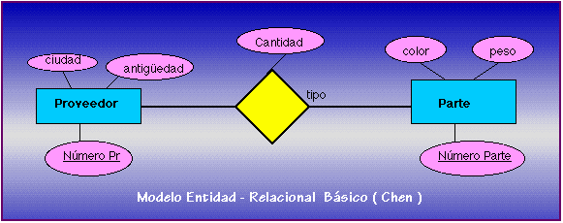
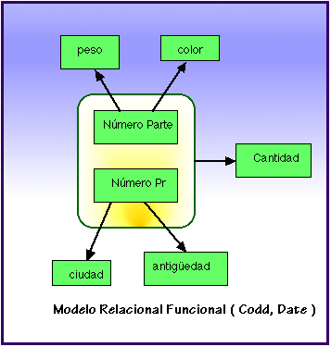
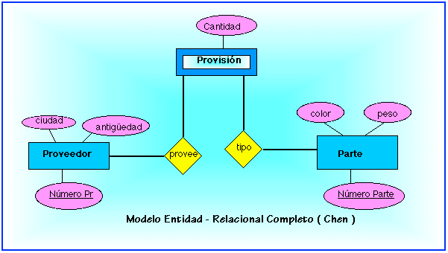
And the E-R model?
Quantity
color
weight
Manager
Description
t
Plant
fitting
weight
color
P #
F #
Fitting
Chen’s
Quantity
Plant
Quantity
Manager
Description
Stock
Codd’s
weight
color
Manager
Description
Plant
m
t
fitting
P #
F #
Chen’s

Slide 14

Modeling Reality
Enterprise
Database
Relations and
information flows
Num Fitting Cost
brass
hinge
tap
Day Num Status
Mon
Tue
Wed
Wrong
Truth is the conformity that exists between the thing (reality of the enterprise) and the description of it (database)
Saint Thomas Aquinas (1224-1275)
A good model generates
a lasting design

